Slide 1
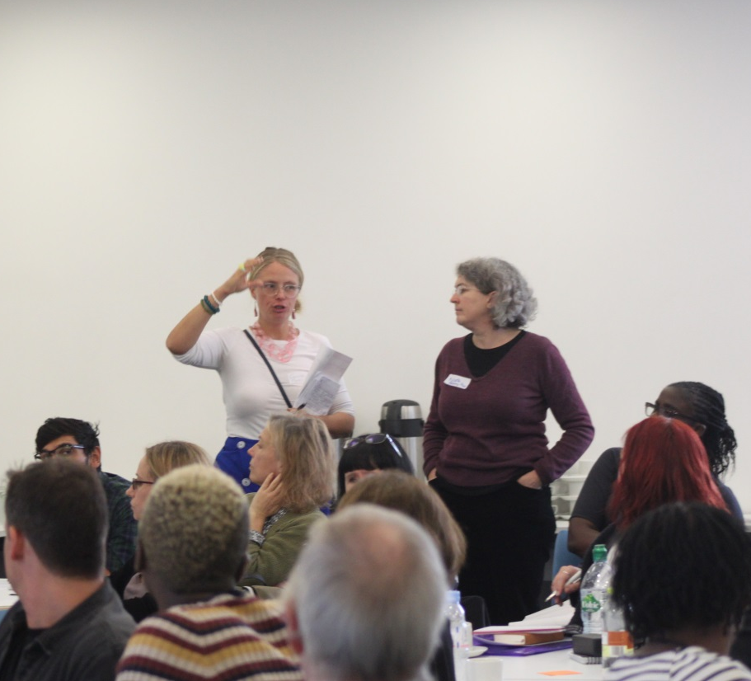
The Voluntary Sector in the Integrated Care System
Hackney and City

Slide 2
Voluntary Sector in Hackney
health and social care organisations
the advice sector
children and young people
the arts and cultural sector
grass roots community action
works to address the socio-economic factors that affect people’s health and ability to participate in community life

Slide 3
Voluntary Sector in Hackney
Approximately 1500 - 2000 organisations
From just 19 known external funders the VCSE brought in over £31m of additional cash resources to Hackney between January 2015 and December 2016
In 2016-17, the Local Authority investment was approximately £23m - of which £18.9m was for services commissioned by the Council
Local VCSE is made up of commissioned and non commisioned organisations - majority of organisations are non commissioned
61% of Hackney CVS members have 5 or less staff, with many having no staff.

Slide 4
Voluntary Sector Contribution to Integrated Care System
Body of evidence on Community Centred and Asset Based approaches to health positively address:
Wider Determinants of Health
Health Inequalities

Slide 5
Community organisations in Hackney
Communities of interest i.e. parents groups; older peoples informal groups;
Communities of geography: Tenants & Residents Associations; estate based community gardens;
Communities of ethnicity: BAMER led organisations: ie Turkish organisations; Vietnamese organisations;

Slide 6
Community sector in the Integrated Care System
Supporting people to connect with each other (low level ongoing maintenance)
Supporting the self care agenda’ and healthy living
Signposting and information (supporting people to utilise services appropriately)
Appropriate and timely escalation of people to statutory services when needed.
Facilitating peer support groups
Providing literacy / language support (reading letters / basic low level advocacy)
Promoting the uptake of screening programmes
Offering community bases for some planned care outpatient appointments
Hosting apprentice positions such as community interpreters / advocates – with career progression into mainstream services

Slide 7
Community sector in the Integrated Care System
Source ( Dr Brian Fisher Chair NHS alliance and Dr Gabriel Chanan – Health Empowerment Leverage project)

Slide 8
Examples of work with the Community Sector
Bowel Cancer Screening Promotion – funded via the Healthier Hackney & City fund this project is testing if community led culturally specific interventions, working in partnership with GP’s, lead to an uptake in Bowel Cancer screenings
Information and Signposting – Funded by the CCG this project is working to support residents furthest from services to access them, through training and funding 6 BAMER community organisations in partnership with Doctors of the World to give accurate signposting to people in need of health support and support those having difficulty registering with a GP or accessing healthcare due to immigration status. This programme reaches over 1000 people a year.
Condom Distribution – Funded by Public Health – this project is a payment by activity contract to register Hackney’s African residents aged 25 onto the Free Condom Project. This project has engaged and signed up over 850 people per year.

Slide 9
Examples of work with the Community Sector
Peer Support Grants -Funded by the CCG this project has funded over 324 Hackney residents with long term health conditions to receive 12 weeks peer support through community organisations , in their own language or in an area near them
Coordinating and recruiting the training of Youth workers in mental health first aid (60 participants) and coordinating four 5 week mental health group supervision sessions for frontline workers in the VCS.
Providing safeguarding awareness training through a community champion model – in partnership with the Adult and Children Safeguarding Boards unfunded
Faith Network: In partnership with London Borough of Hackney policy team, Hackney CVS has set up an embryonic Faith Network. This is to work with faith leaders and to offer them training and support in a range of areas such as safeguarding;

Slide 10
Voluntary sector in the Integrated Care System – current enabler work
Development of the cross sector dataset and digital referral system for social prescribing
Supported Employment via a cross sector network
Employer Engagement
Professional Accreditation Sourcing Additional Funding
Advice Sector - networking, integrating, preparing advice organisations
Navigation and referrals- navigation roles in the borough
common language / competency framework;
understanding the criteria and gaps

Slide 11
VCSE structures in Hackney

Slide 12
VCSE Transformation Leadership Group
Health & Social Care Forum – main network for VCSE involvement in Integrated Care System (weekly e-news/ quarterly meetings/subgroups )
a key agent of the HSCF: acting as an accountable structure for the voluntary and community sector's engagement in the Integrated Care System and leading the development of a neighbourhood pilot.
Made up of VCSE representatives – who are chosen via a transparent recruitment process
Current membership VCSETLG: 13 representatives who sit on boards as HSCF representatives
Report back to wider sector via HSCF meetings and e-newsletter

Slide 13
Governance Review workplan 2019
Protocols for managing conflicts of interest of members of the board and those of Hackney CVS as both a commissioner, facilitator and consortium lead.
New partnership agreements, strategic alliances or memorandums of understanding between VCS organisations working on common areas/service provision
Contracting processes and relationships with commissioners and between those commissioned
Communication to the wider sector
Appropriate allocation of core funding
Review points for the next 12 months

Slide 14
VCS pilot Neighbourhoods 19-20
Well Street Common Neighbourhood

Slide 15
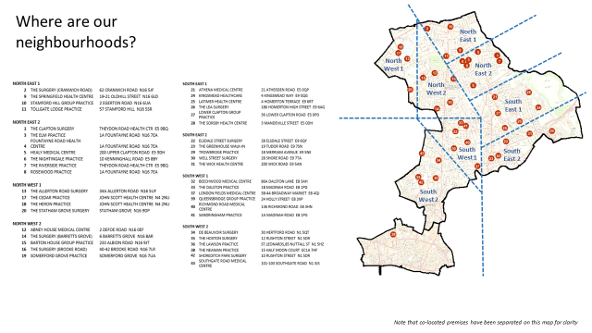
The Neighbourhoods
8 neighbourhoods in Hackney, based around GP practices
30-50,000 residents per neighbourhood
The City
South West 1 | London Fields Neighbourhood
South West 2 and City | Shoreditch Park & City Neighbourhood
South East 1 | Hackney Marshes Neighbourhood
South East 2 | Well Street Common Neighbourhood
North East 1 | Springfield Park Neighbourhood
North East 2 | Hackney Downs Neighbourhood
North West 1 | Woodberry Wetlands Neighbourhood
North West 2 | Clissold Park Neighbourhood

Slide 16
Drivers
Social determinants of health – high needs in the neighbourhood, homelessness, Pro-Active care list, benefits
Long term structure for VCS engagement in neighbourhoods
VCS specific roles and skills
Based on the Sheffield model, testing key parameters for the Hackney context

Slide 17
VCS pilot in a nutshell
Patient outcomes
Advice
Daily living skills support
Coproduce a common competency framework
Governance
Neighbourhood partnership
Links to VCSETLG
Sustainability
VCS orgs training
Peer network
Fundraising

Slide 18
Activities
Map advice / daily living skills support provision across the - including capacity and waiting lists, with a micro focus on two neighbourhoods: Well Street Common and Clissold Park. Focus on needs of complex clients (Pro-Active care list, MDT, Wellbeing Network, Social Prescribing, local partnership)
Co-produce a common competency framework needed from advice service/ daily living support
Creation of Neighbourhood partnership
Identification of lead VCS organisation
Training of local VCS organisations in peer support, signposting, working in neighbourhood structures
Matched fundraising to support sustainbility

Slide 19
Key aligned pilots
Well Street Common VCSE led Pilot - focus on social determinants of health
GP Confederation priorities in Clissold Park Neighbourhoods – Citizen’s advice
Care Navigation Pilot -potential for cross sector training in key competencies such as whole systems thinking; motivational interviewing; navigation/ assisted referrals

Slide 20
Outcomes
Test partnership structure
Advice and daily living skills provision
Peer training and neighbourhood volunteers group for partnership
Local VCS organisations trained and supported to work with residents and local groups

Slide 21
Next steps January-March
Evaluation framework – to be finalized following the January workshop
Recruitments
Engagement and preparation meetings with Well Street Common VCSE organisations
Engagement and preparation meetings with GP clinical leads
Coordination with other pilots

