Slide 1
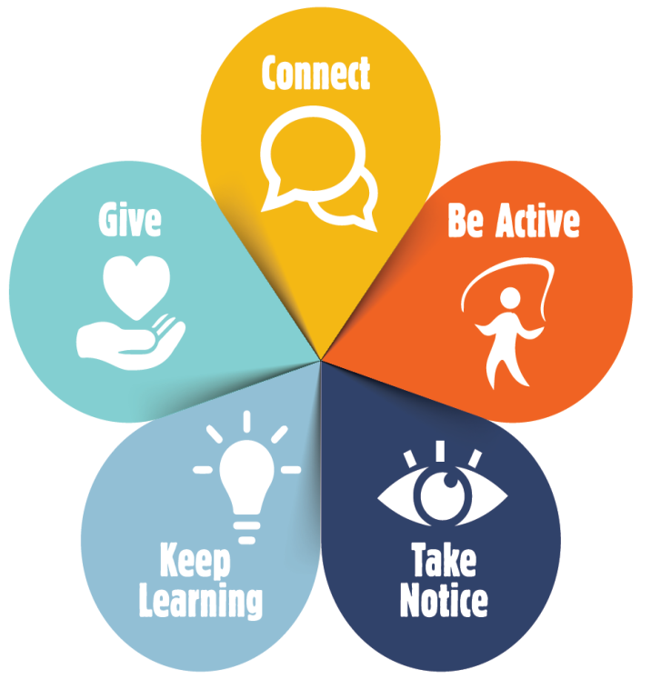
Background
5 to thrive refers to five simple things that you can do to improve your mental health and wellbeing.
They are evidence based ways and do not require prior training or expertise. The five ways are:
CONNECT: With people around you, family, friends, colleagues and neighbours. At home, work, school or in your local community. Building these connections will support and enrich you every day.
BE ACTIVE & HEALTHY: Exercising makes you feel good. Go for a walk or run, cycle, garden, dance. Most importantly, find a physical activity you enjoy and that suits your level of mobility and fitness and make it part of your life.
BE MINDFUL: be more aware of the present moment, including your feelings and thoughts, your body and the world around you. This awareness can be called "mindfulness", and it can positively change the way you feel about life and how you approach challenges.
KEEP LEARNING: Learning new skills can give you a sense of achievement and a new confidence. Try something new. Sign up for that course. Fix a bike. Learn how to cook your favourite food.
Give & WORK: Giving your time and being kind can be very rewarding, boosts your mood & increases
your wellbeing. Do something nice for a friend. Volunteer, Join a community group.

